Slide 1

Enterprise Software Development

Slide 2

Software to simplify life

Slide 3


Agenda
Our Company
Our Clients
Our Community

Slide 4
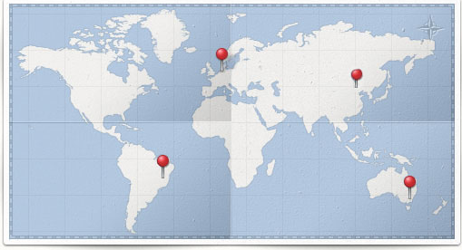
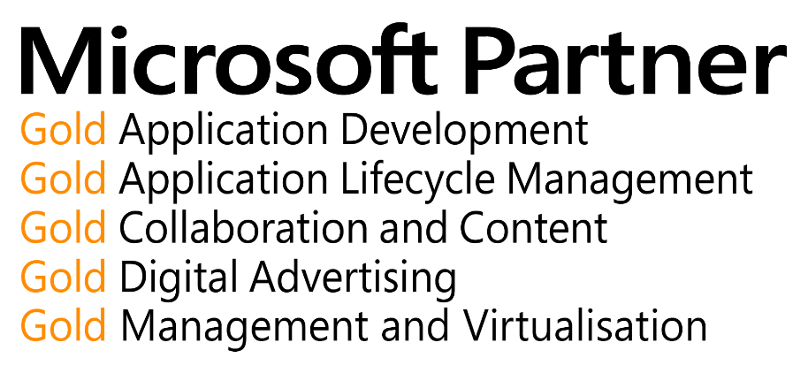
Our Company
With over 25 years of experience under our belt, we know how to reduce risks
5 Microsoft gold level competencies
40 employees in 4 countries

Slide 5



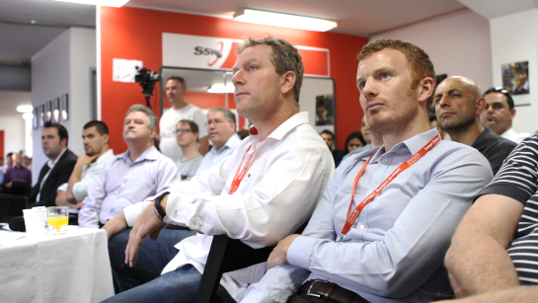

Our People
5 MVPs
2 Regional Directors
Speakers at international and national conferences
Lecturers at Universities

Slide 6
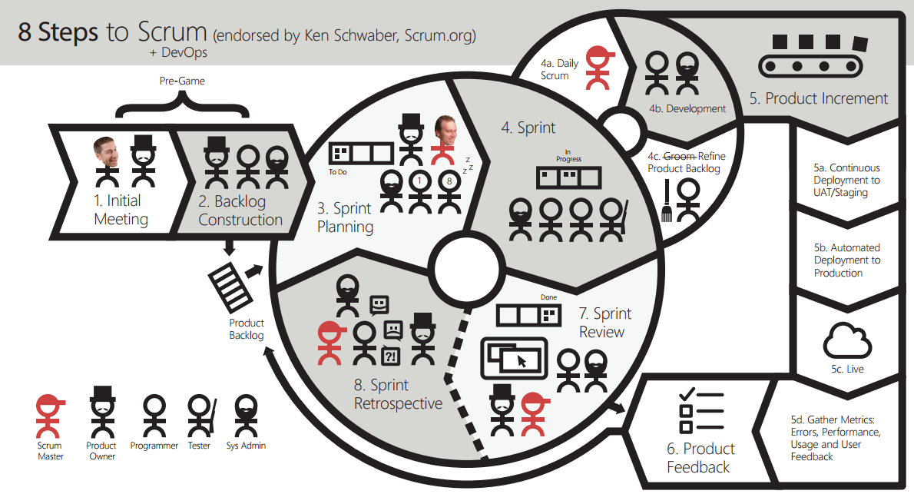
Our Process

Slide 7

Solutions
Line of business applications
Intranets
Public facing web sites
Mobile apps
BI and reporting
Training

Slide 8
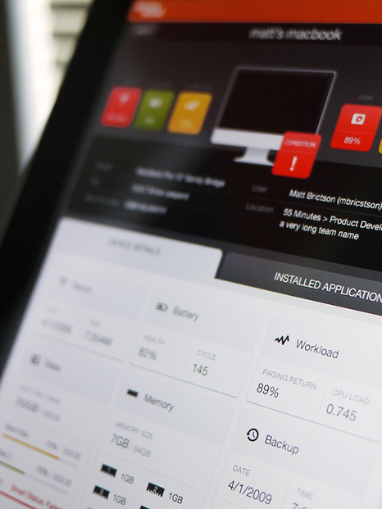
Line of Business Apps
Scheduling
Timesheets
Asset Management
Accounting
High performing, custom applications…

Slide 9




Line of Business Apps
ASP.NET MVC
Dynamics CRM
Azure
SQL Server
Access…

Slide 10

Mobile apps
Native applications
Cross platform apps (ios, android, windows phone) via xamarin
Responsive design web apps
Choosing the right platform and technologies to reach your audience

Slide 11
Intranets
Collaboration
Document Management
Search
Calendars
Portals
Customising SharePoint to fit your specific needs

Slide 12
Public Facing Web apps
Content Management Systems
E-commerce
Booking Engines
Start-ups
Web Services
Building your online presence using MS technologies

Slide 13
Agenda
Our Company
Our Clients
Our Community

Slide 14
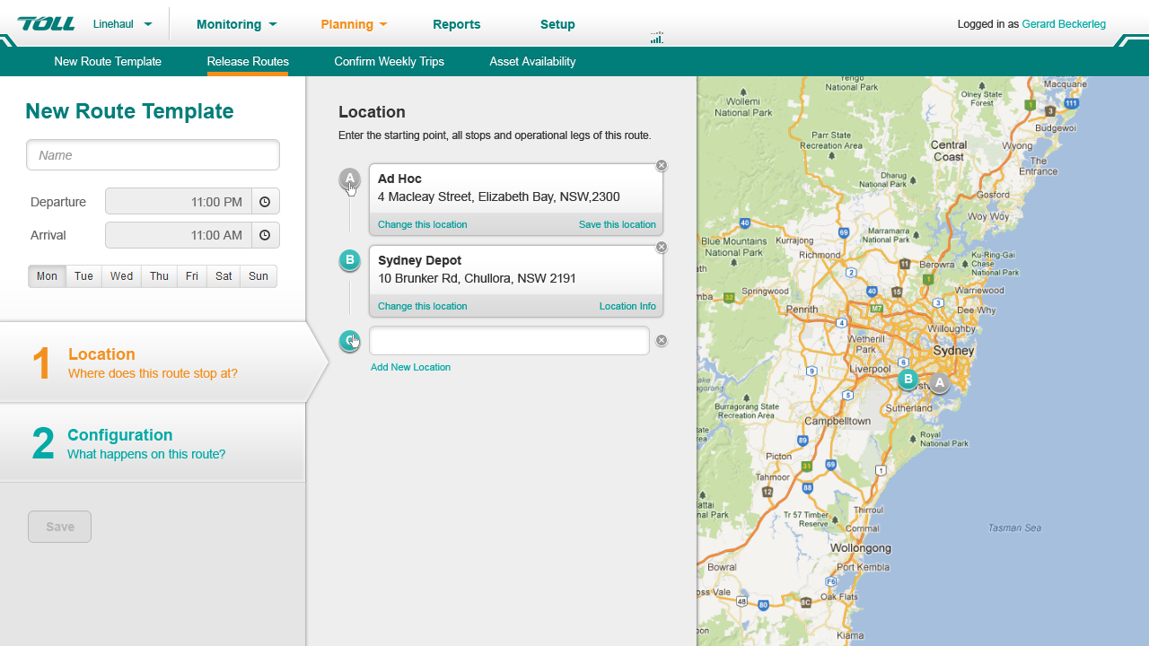
“Is this vehicle where it’s supposed to be?”
Toll Linehaul

Slide 15
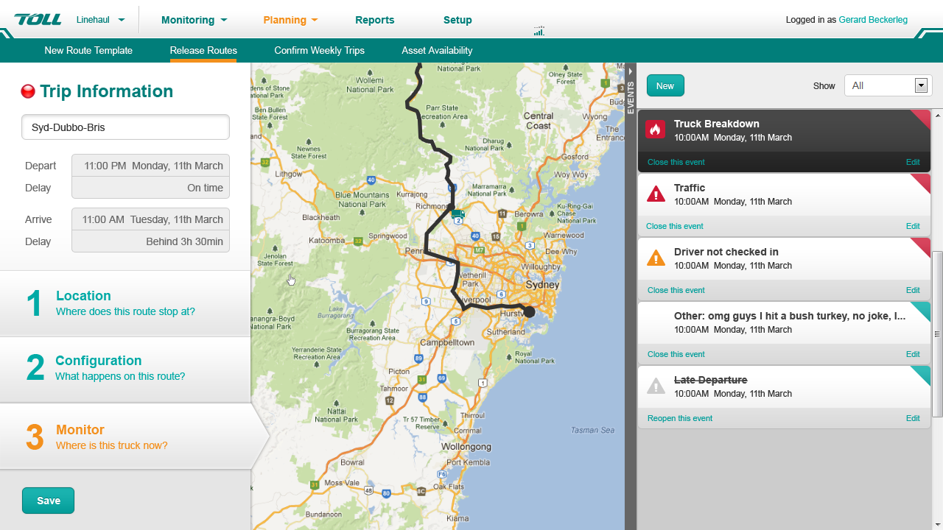
ASP .NET MVC
Knockout JS
Typescript
Google Maps API

Slide 16
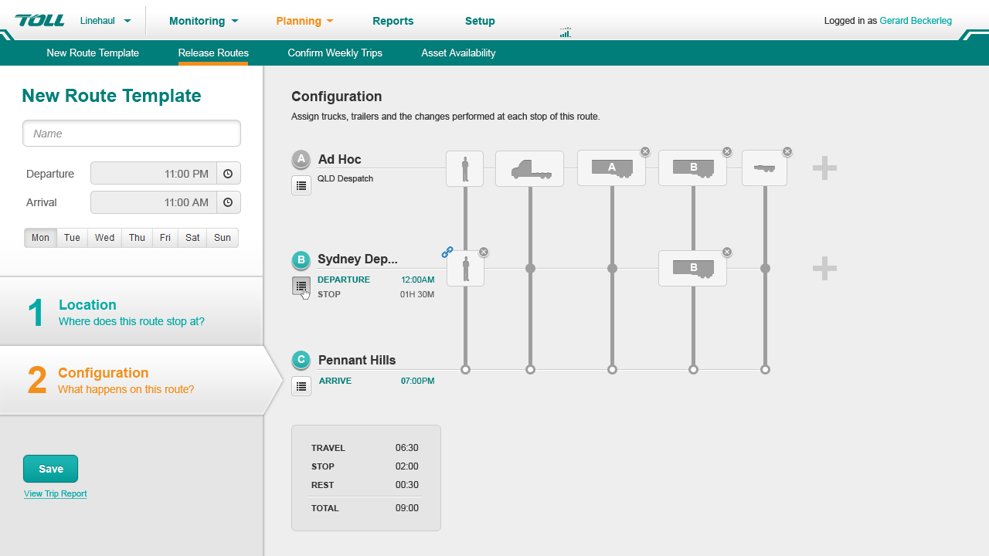

Slide 17
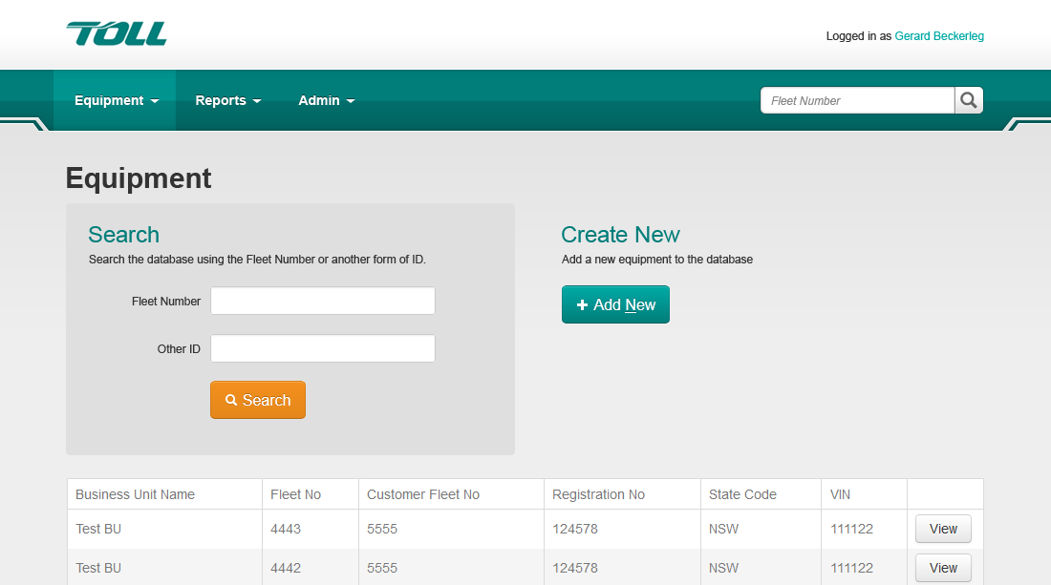
A system to track and centralize truck registry
Toll Express

Slide 18
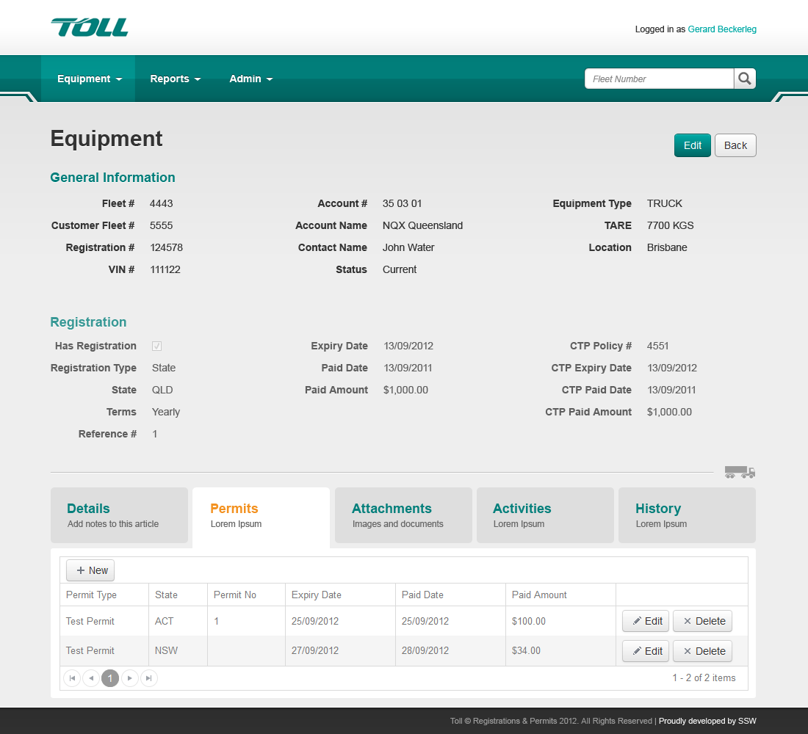
ASP .NET MVC
SQL Server
SQL Reporting Services
Kendo UI

Slide 20
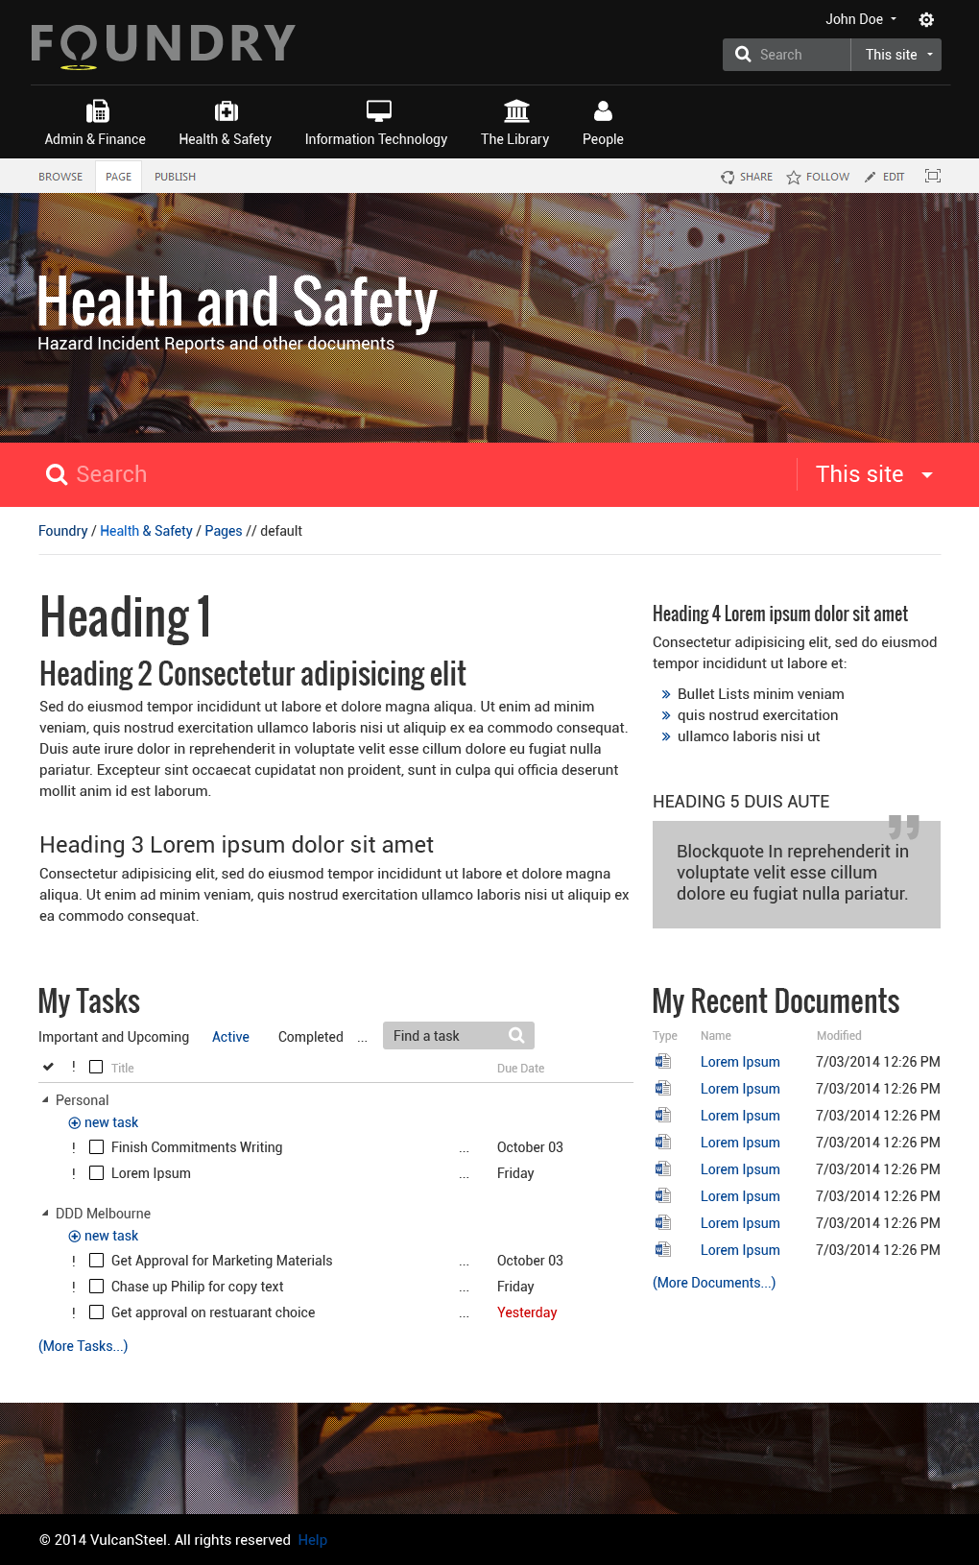
Responsive SharePoint Intranet
Vulcan Steel

Slide 21
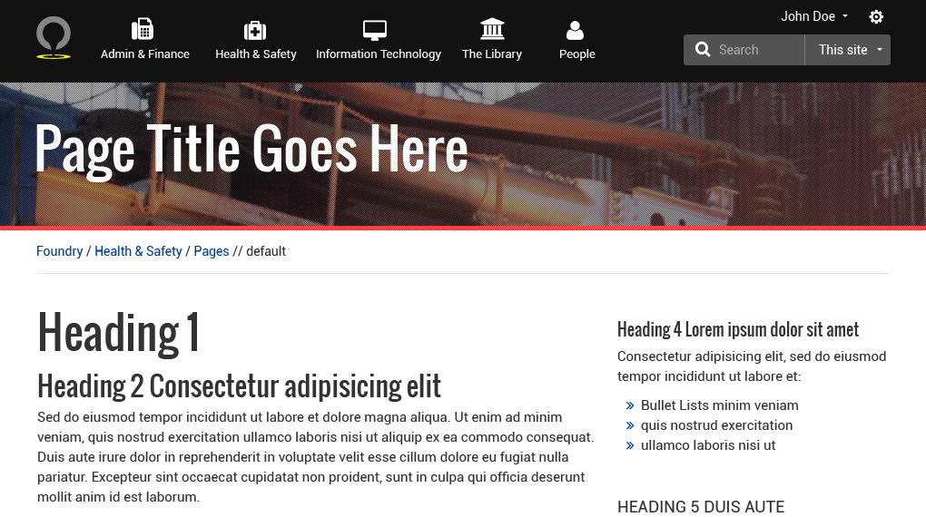
SharePoint Online
Angular JS
jQuery
Twitter Bootstrap

Slide 22
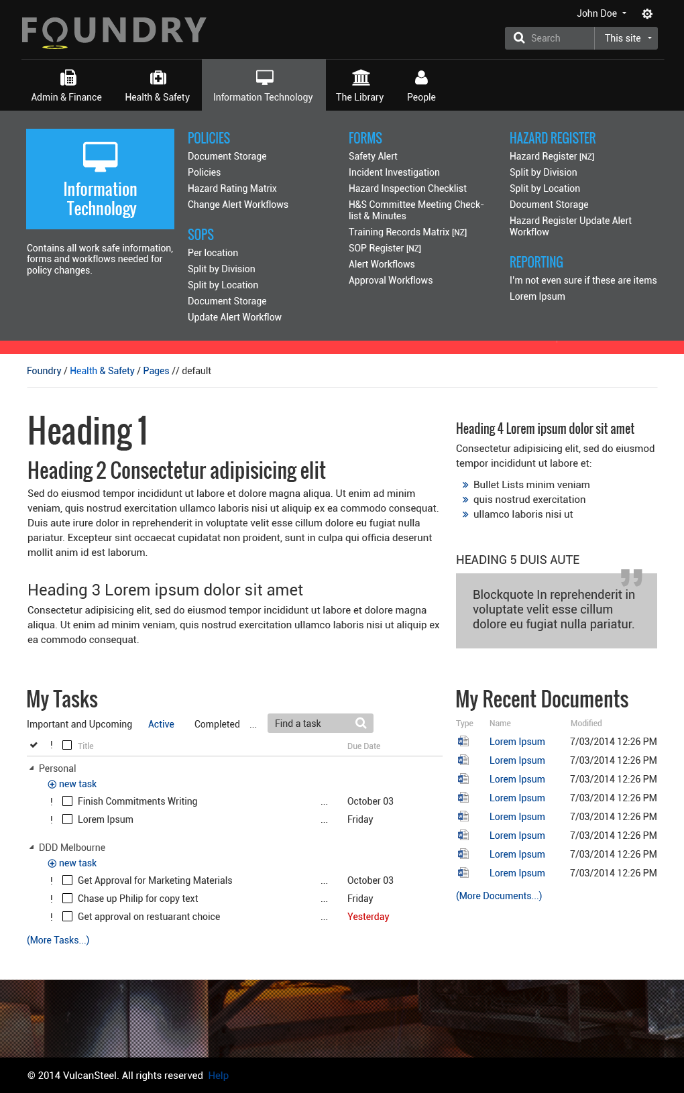

Slide 23
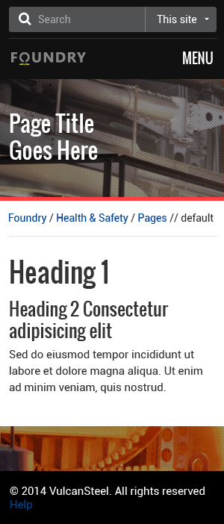
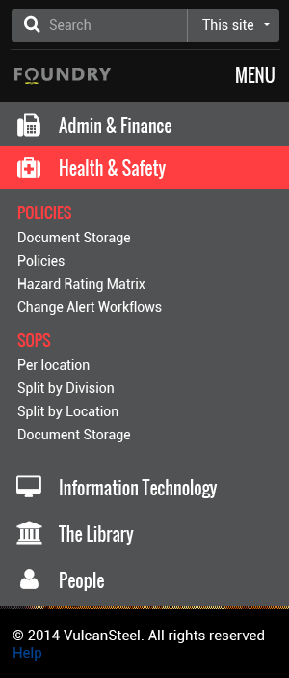

Slide 24
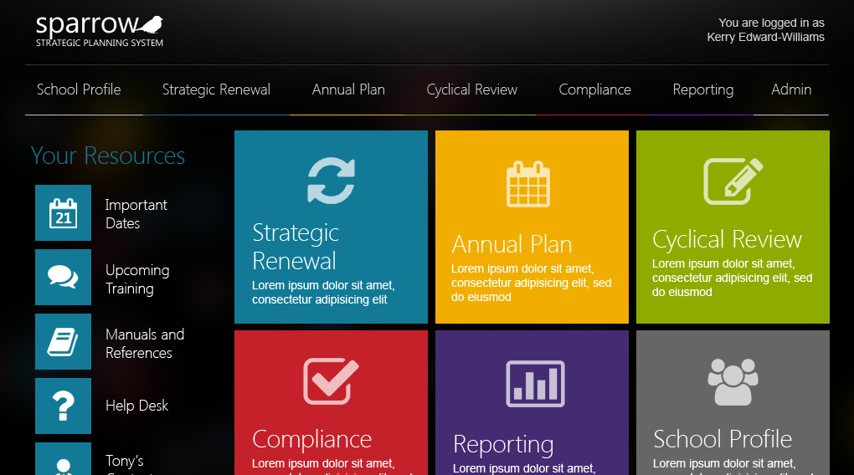
Tablet Focused Curriculum Management System
Brisbane Catholic Education

Slide 25
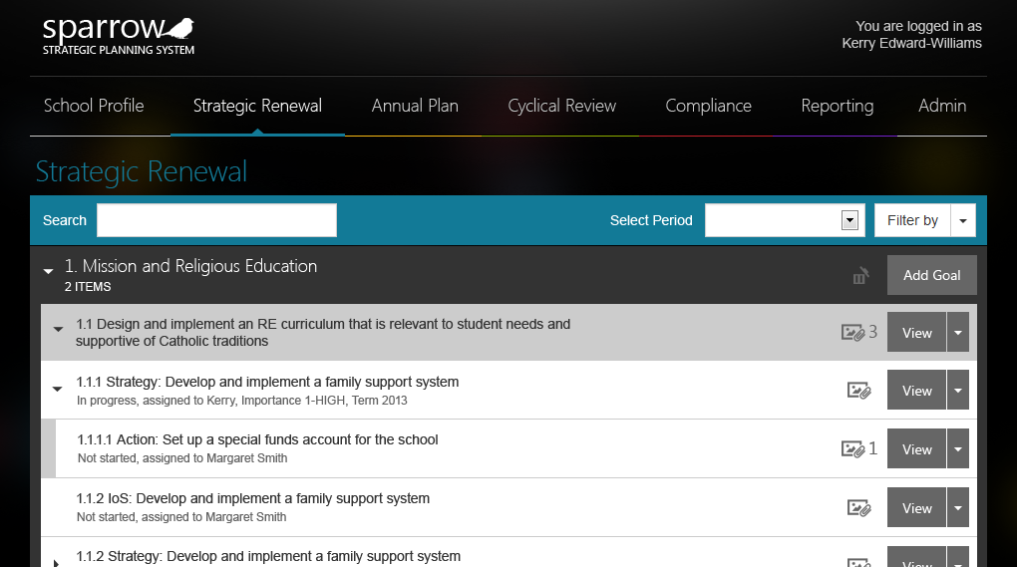
ASP .NET MVC
SQL Server
jQuery
Twitter Bootstrap

Slide 26
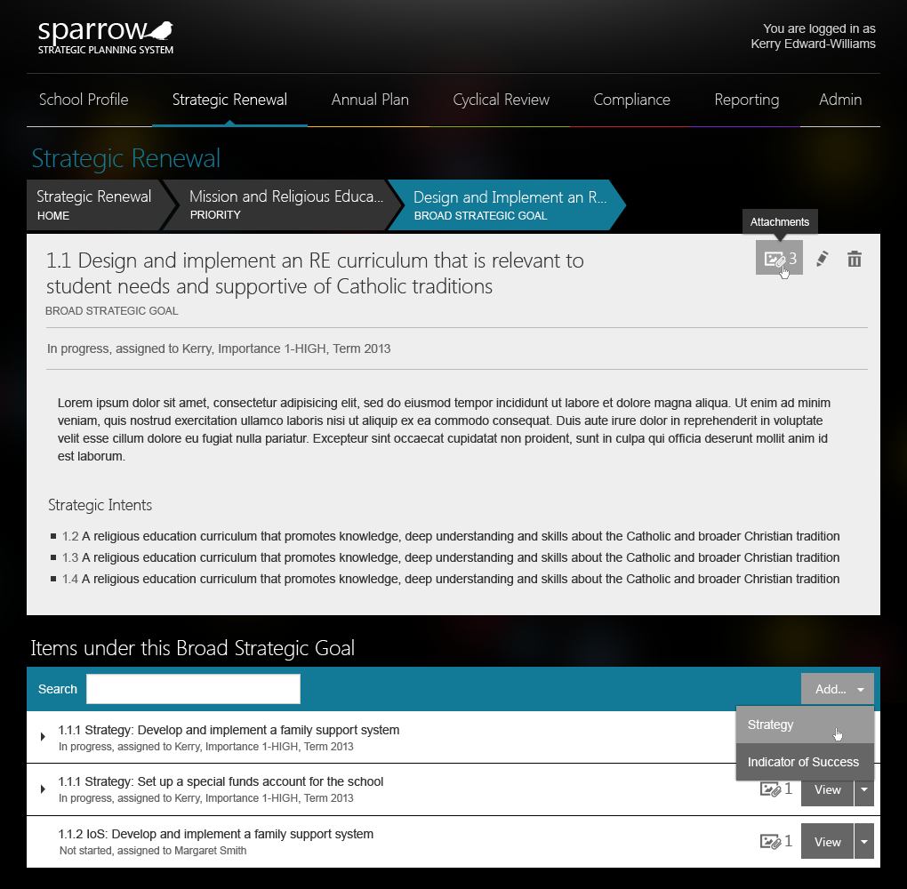

Slide 27
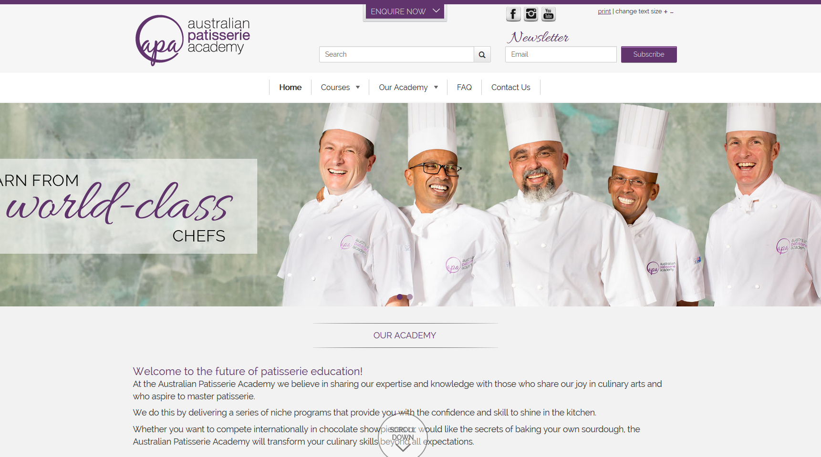
Responsive Website TAFE Course Selection
Australian Patisserie Academy - TAFE

Slide 28
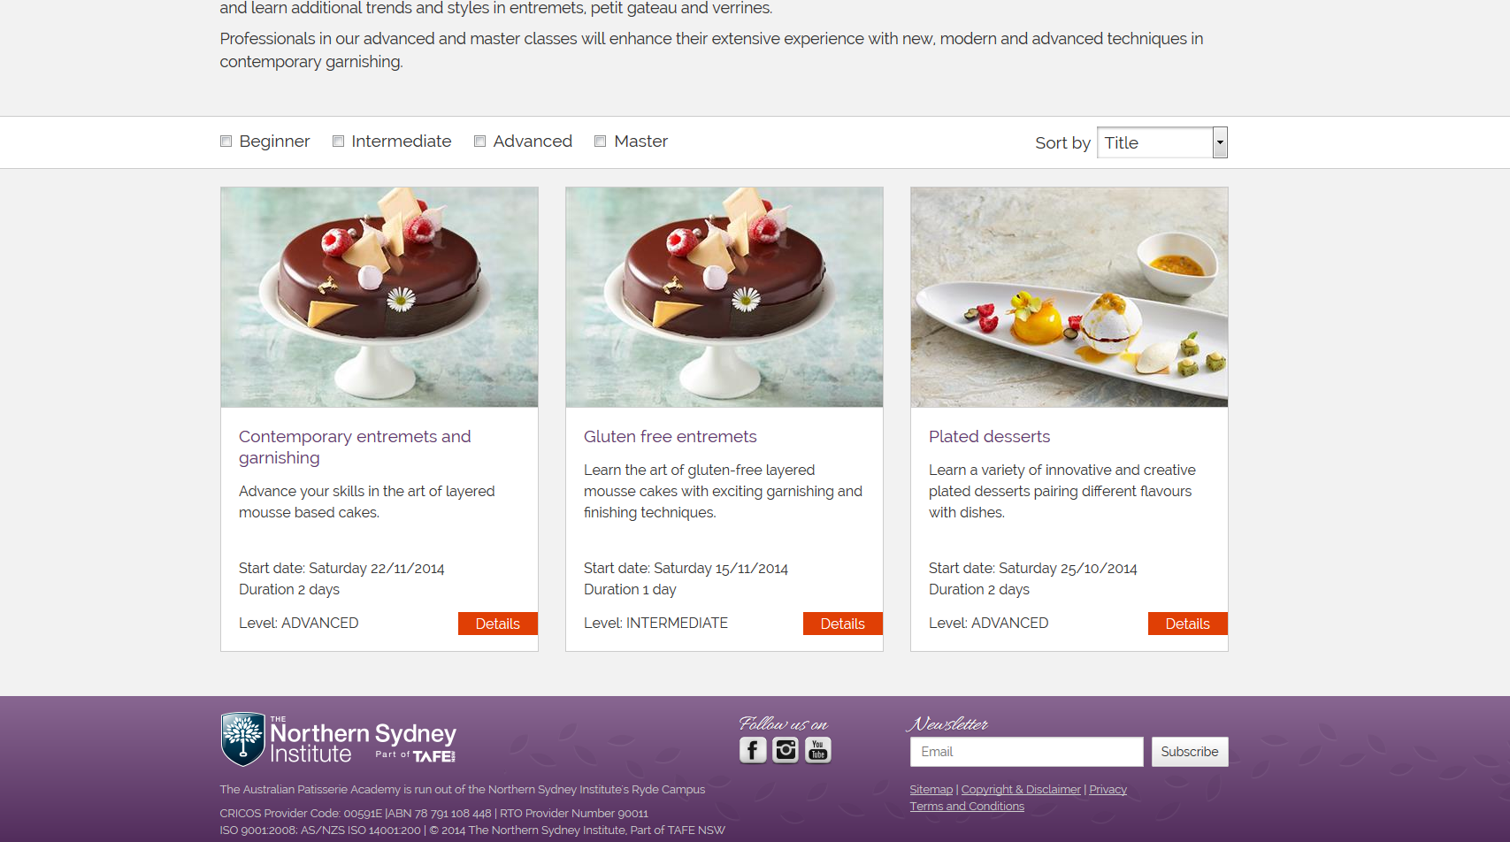
Sitefinity

Slide 29
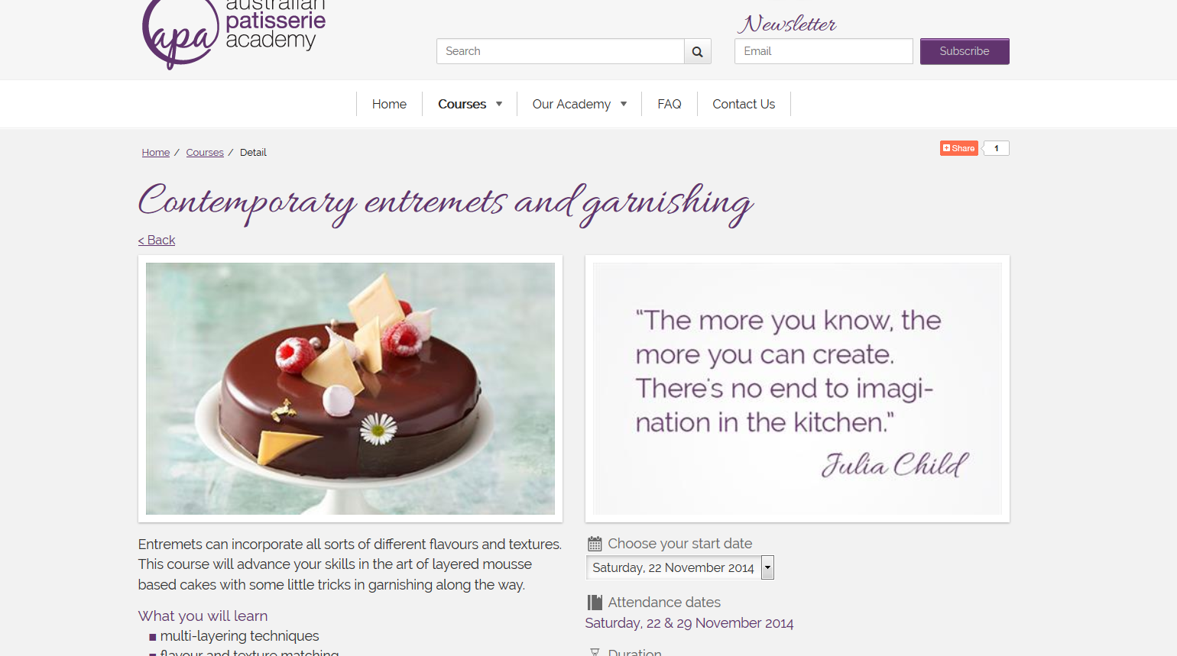

Slide 30
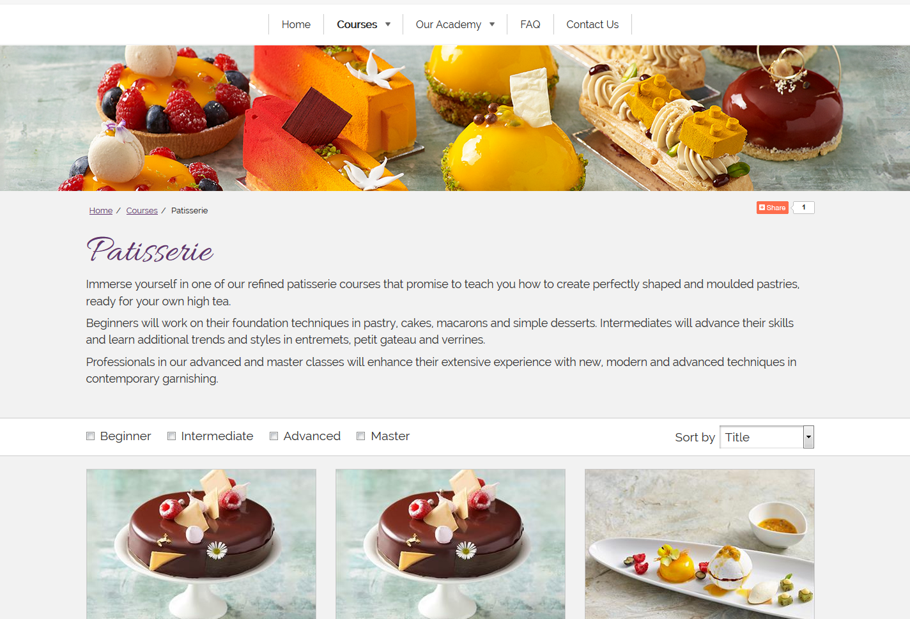
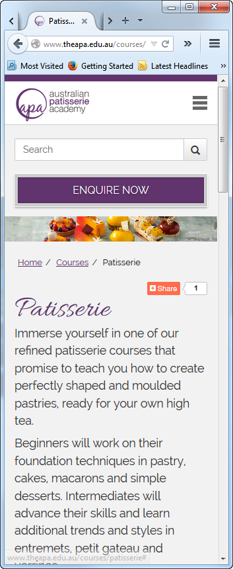

Slide 31
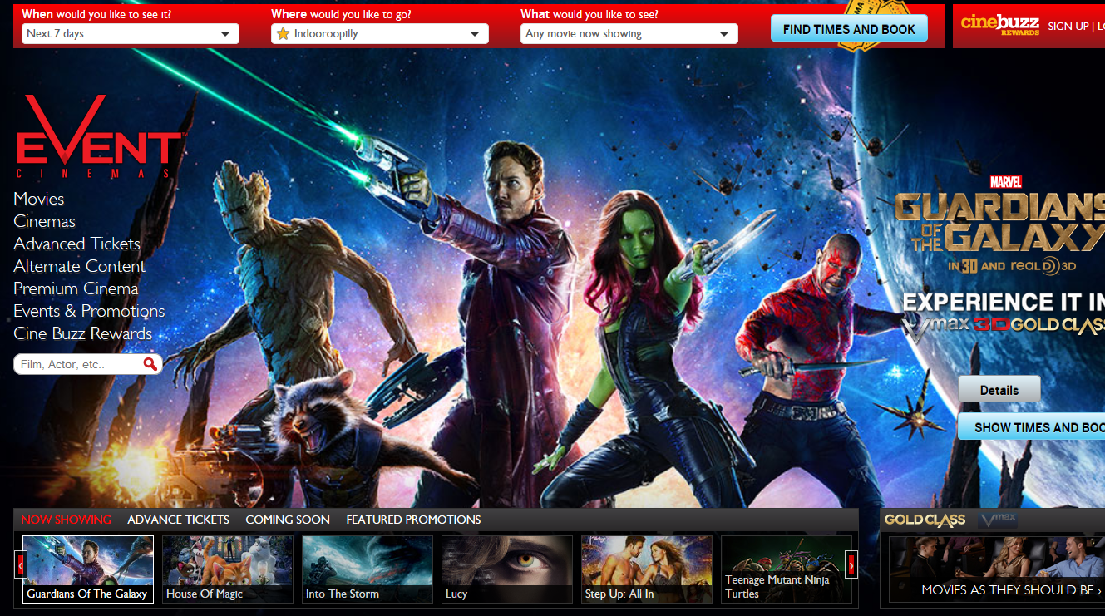
Robust ticketing system
Event Cinemas

Slide 32
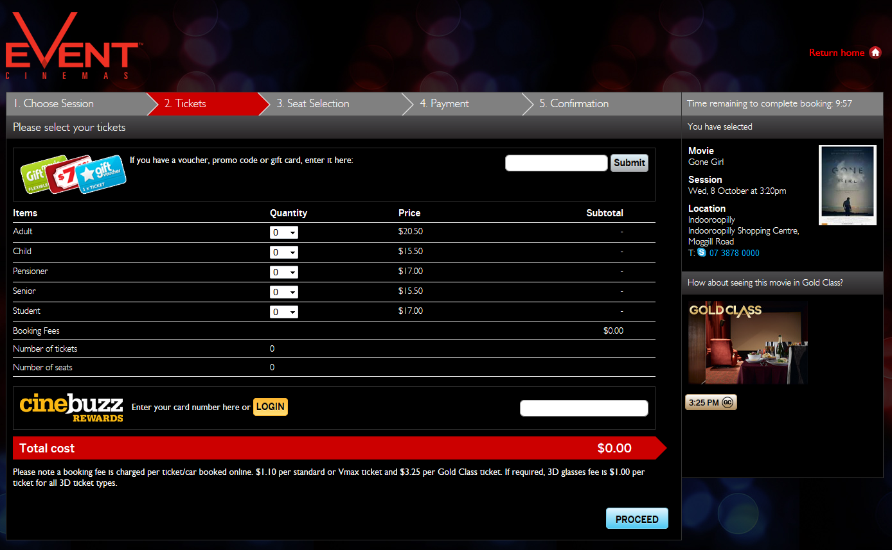
Sitefinity
SQL Server
jQuery
ASP .NET MVC

Slide 33
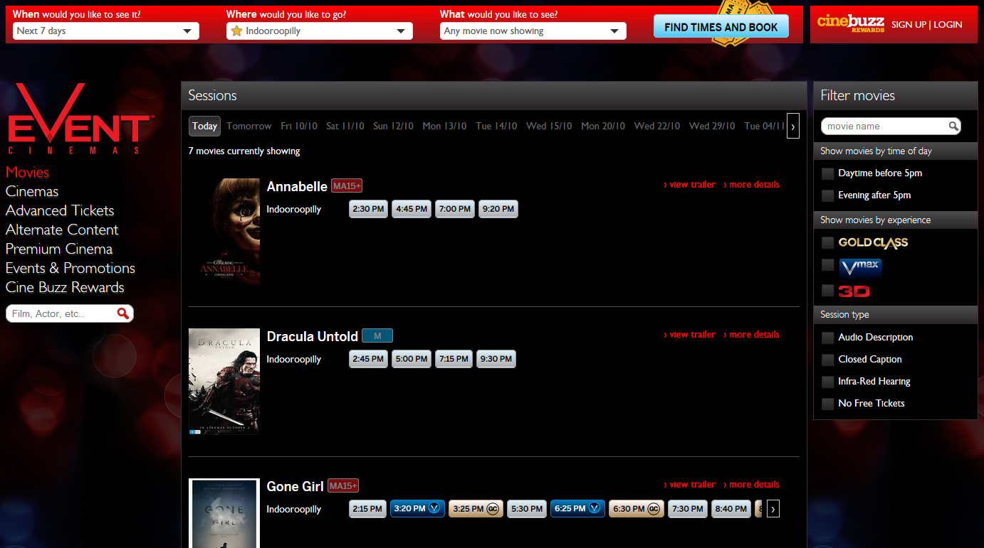

Slide 34
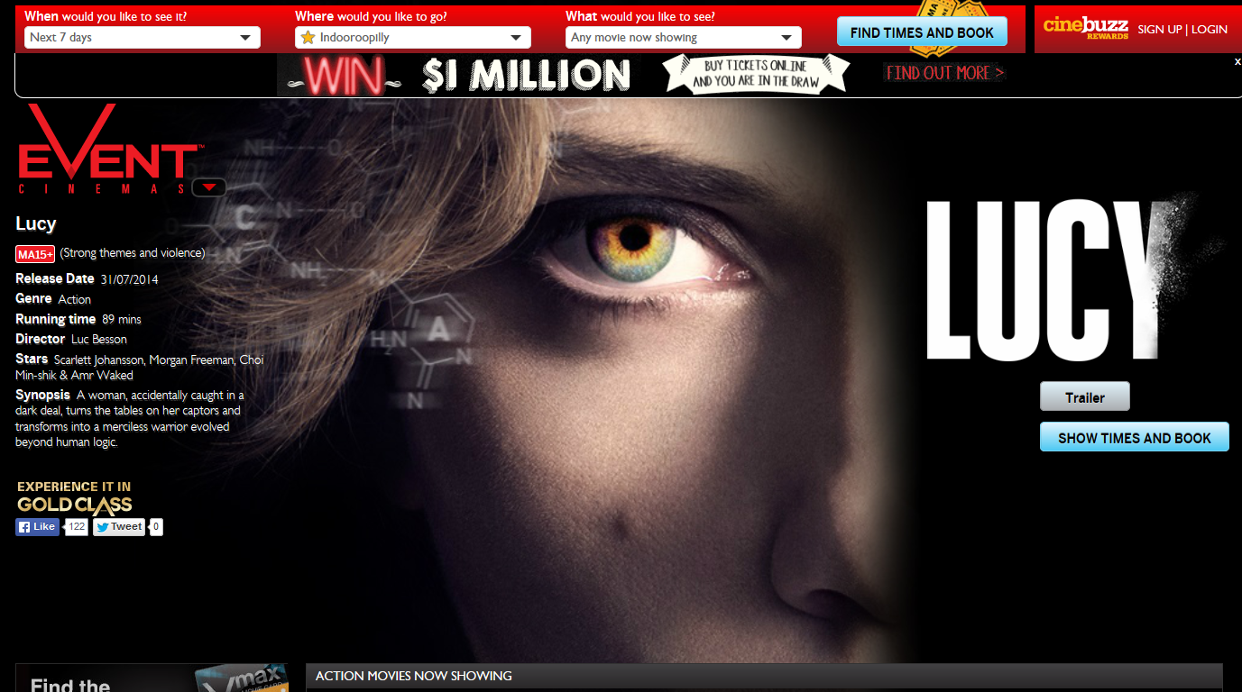

Slide 35
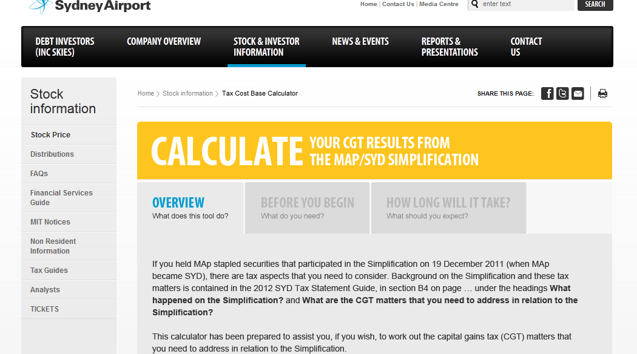
Investment Tax Calculator
Sydney Airport

Slide 36
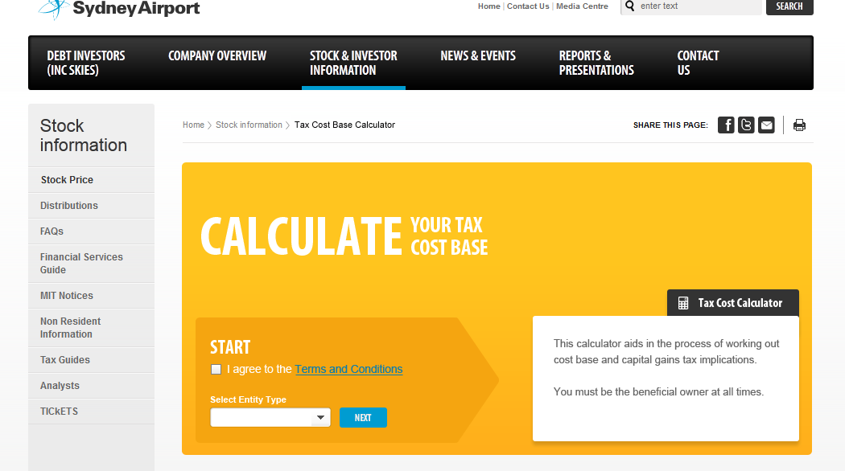
ASP .NET MVC
SQL Server

Slide 37
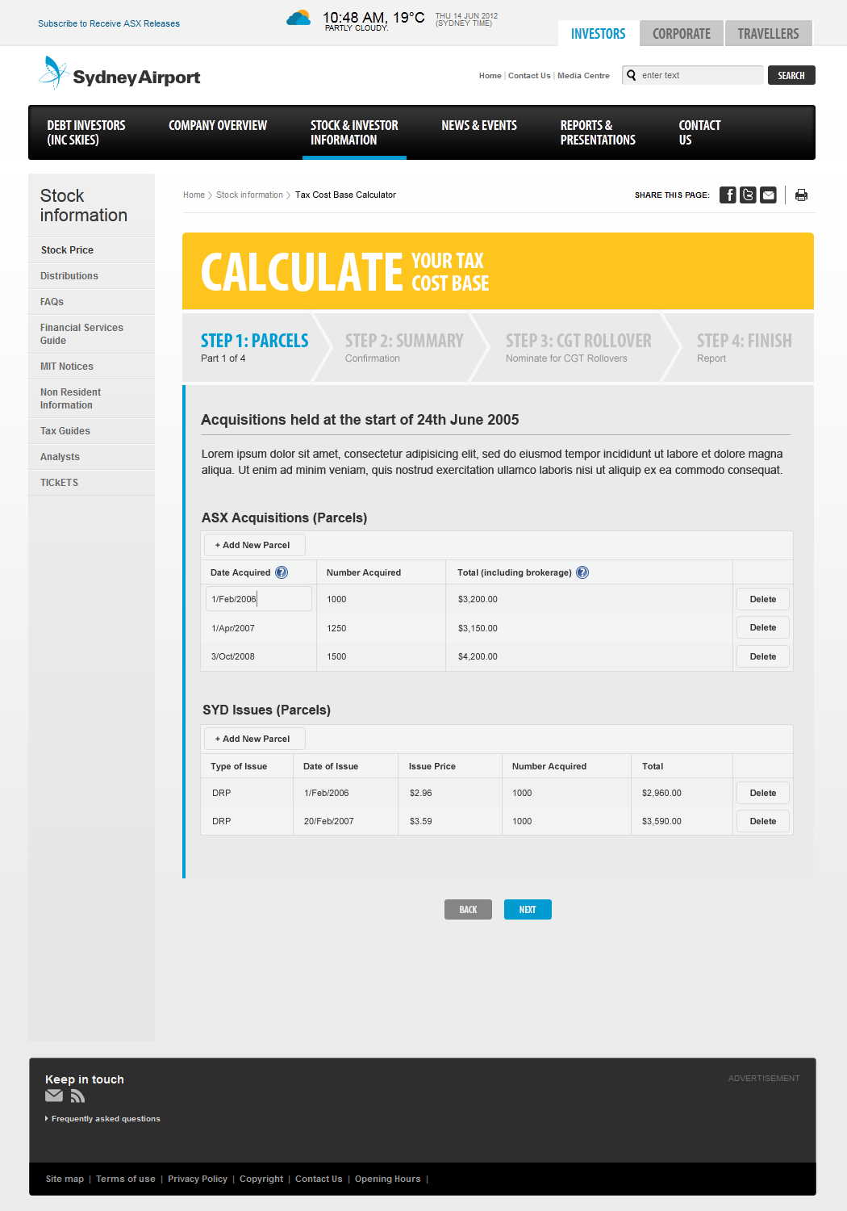

Slide 38
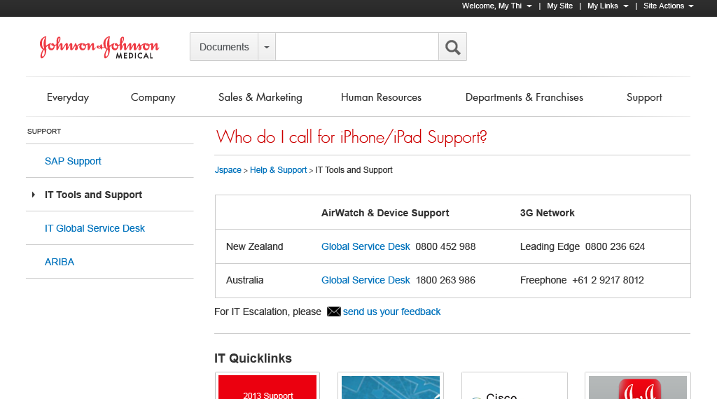
Design of Intranet and Information Architecture
Johnson & Johnson Medical

Slide 39
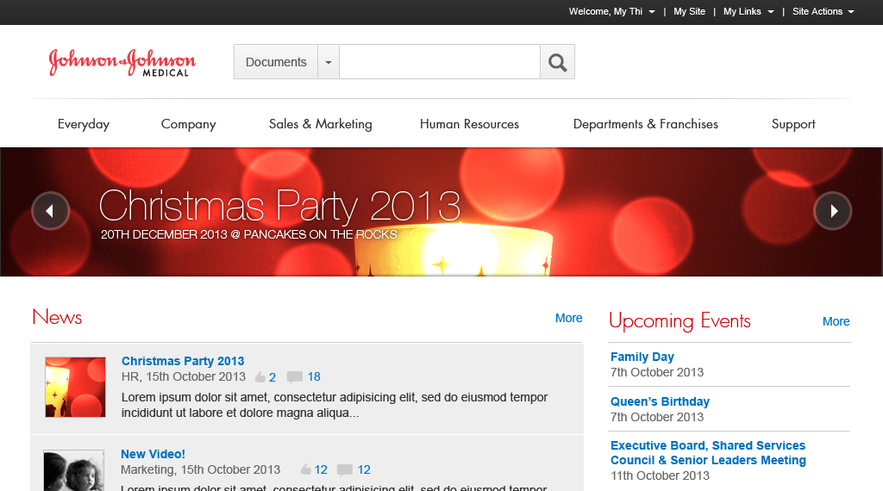
SharePoint
jQuery

Slide 40
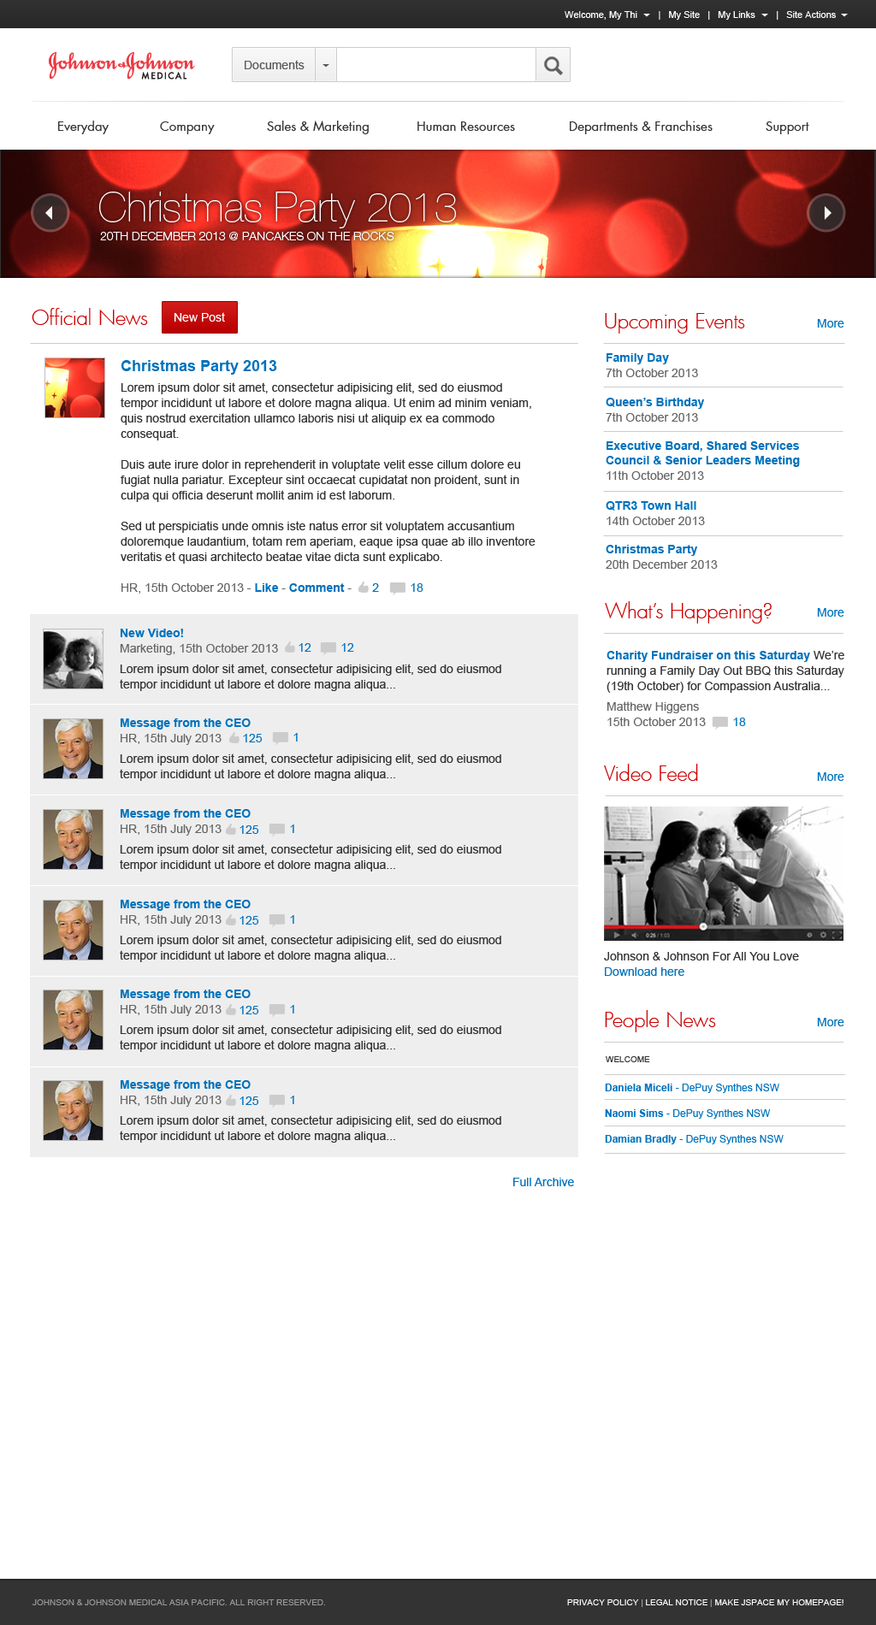
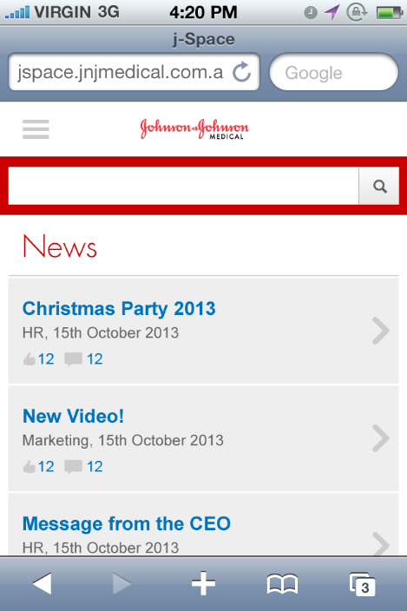

Slide 41
Agenda
Our Company
Our Clients
Our Community

Slide 42

Training & Mentoring
ASP.NET MVC
Latest Technologies
TFS
Scrum
SQL Server

Slide 43
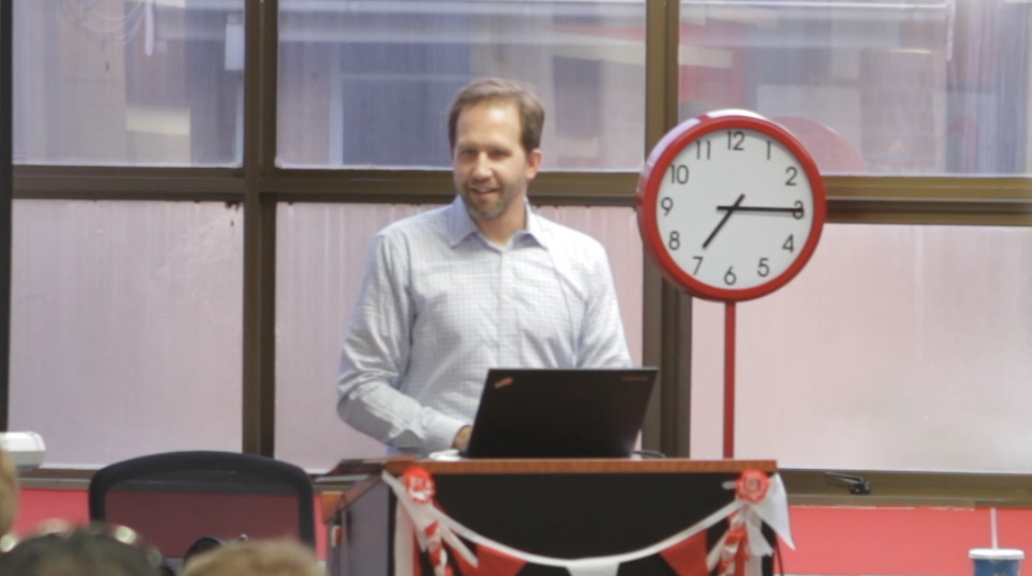
Sydney and Canberra .NET User Groups

Slide 44
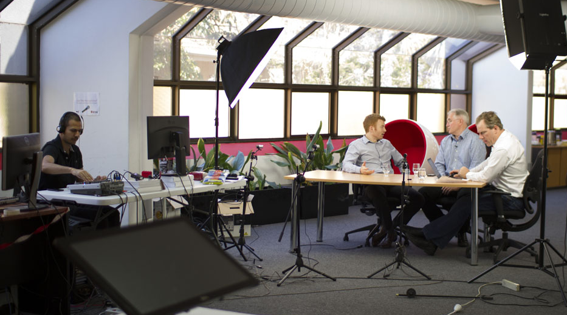
SSW TV

Slide 45
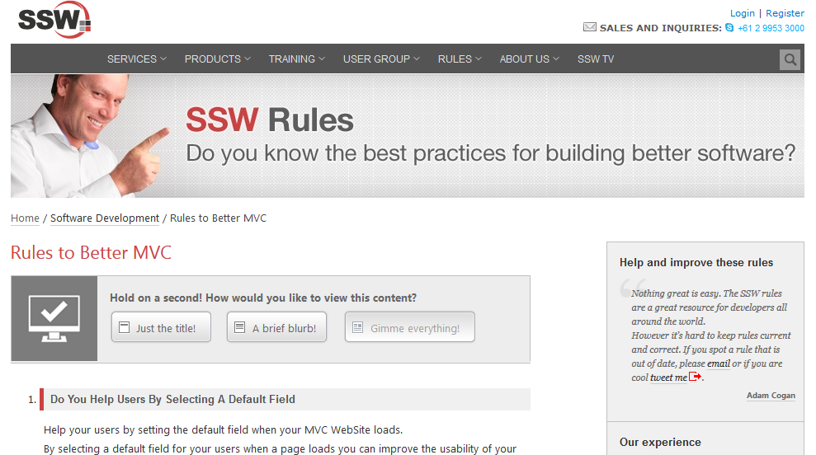
SSW Rules

Slide 46
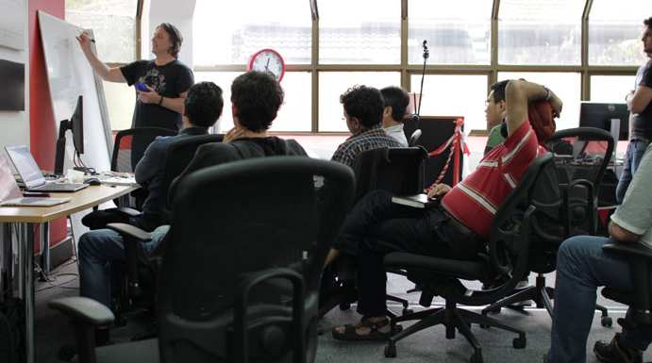
FireBootCamp.com

Slide 47
Thank you! info@ssw.com.au www.ssw.com.au Sydney | Melbourne | Brisbane | Adelaide

